Slide 1
Design Dynamics: managing change
Presented By
Halil Cicibaş
halil.cicibas@metu.edu.tr

Slide 2
Outline
Introduction
Where are you in the step by step approach?
What should you change first? And Second?
Why change? Should we live with some misfits?
What are the benefits of change?
What are the difficulties of change?
Managing misfits over time
Dynamic fit and time
The organizational life cycle
Summary

Slide 3
Introduction
Chapter addresses
Why do we need change
Where to start change process
How to plan each step
How to execute it systematically

Slide 4
Outline
Introduction
Where are you in the step by step approach?
What should you change first? And Second?
Why change? Should we live with some misfits?
What are the benefits of change?
What are the difficulties of change?
Managing misfits over time
Dynamic fit and time
The organizational life cycle
Summary

Slide 5
Where are you in the step by step approach?
Steps to follow
Complete steps presented in Chapter 1 through Chapter 10
Assesing current organizational design
Identifying misfits
Deciding what you might do to bring the design components into the same quadrant.

Slide 6
Step-by-step approach
Step 2 Strategy Environment
Step 4 Task Design People Leadership Organizational Climate
Step 3 Configuration Complexity Geographic Distribution Knowledge Exchange
Step 1 Scope
Step 5 Coordination, control, Information Systems Incentives

Slide 7
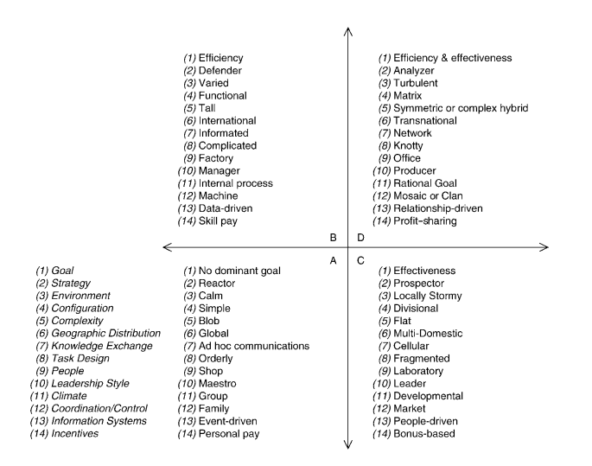
Identify misfits

Slide 8
Decide what you might do
Bring the design components into the same quadrant
Reduce the number of misfits
Tolerate the misfits
Action
Fix All
Reduce
Tolerate

Slide 9
Outline
Introduction
Where are you in the step by step approach?
What should you change first? And Second?
Why change? Should we live with some misfits?
What are the benefits of change?
What are the difficulties of change?
Managing misfits over time
Dynamic fit and time
The organizational life cycle
Summary

Slide 10
What should you change first? And Second?
Fix any misfits within a step before proceeding to the next step
May be need a number of backward iterations
Make changes between steps
If you are able to fix misfits within a step and between steps, you can achieve a success for the organizational design.

Slide 11
Example 1
Two losses in Step 2
The prospector will develop new products and services which are not needed;
The prospector costs will be high.

Slide 12
Example 2
One lose between Step 1 and Step 2
Adopting a defender strategy will not allow the organization to meet its effectiveness goals

Slide 13
Outline
Introduction
Where are you in the step by step approach?
What should you change first? And Second?
Why change? Should we live with some misfits?
What are the benefits of change?
What are the difficulties of change?
Managing misfits over time
Dynamic fit and time
The organizational life cycle
Summary

Slide 14
Why change? Should we live with some misfits?
Any misfits has an opportunity loss
At first galance, all misfits should be changed
If the misfits could be fixed without any cost of change, it would be ok to fix them quickly
But there are difficulties to change organizational components: fixing misfits is not free
Should we live with some misfits? –Yes. Reduce the impact of misfits.
Weigh the benefits of fixing misfits and the cost and difficulties of change process

Slide 15
Balance of change
Difficulties
Fixing Cost
Benefits
Increase performance
Realize efficiency
Leverage effectiveness
Cause new misfits

Slide 16
Outline
Introduction
Where are you in the step by step approach?
What should you change first? And Second?
Why change? Should we live with some misfits?
What are the benefits of change?
What are the difficulties of change?
Managing misfits over time
Dynamic fit and time
The organizational life cycle
Summary

Slide 17
What are the benefits of change?
Changing organizational design
Help realize goals
Increase effectiveness
Improve performance
Misfits
Decrease firms performance
Increase opportunity loss
Not clear whether opportunity loss is directly related with the number of misfits. Since some misfits are more problematic than others.
Therefore, fix some misfits even if you cannot fix them all
When you fix one misfit, you may create another one, be careful!

Slide 18
Outline
Introduction
Where are you in the step by step approach?
What should you change first? And Second?
Why change? Should we live with some misfits?
What are the benefits of change?
What are the difficulties of change?
Managing misfits over time
Dynamic fit and time
The organizational life cycle
Summary

Slide 19

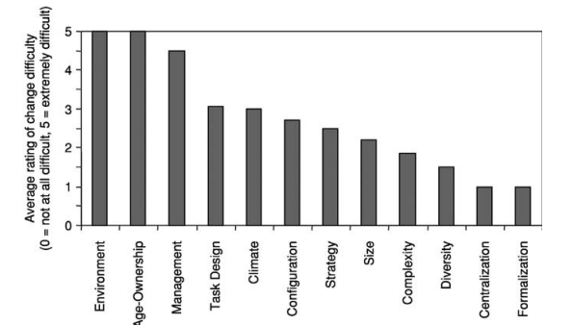

What are the difficulties of change?
Asked executive MBA students who are practicing managers.
Some misfits are easier to fix.

Slide 20
What are the difficulties of change?
Formalization of the organization is the easiest to change
Rules of firms, can be easiliy added new rules or changed.
The environment is the most difficult to change
New markets, products or services
Influence the strategy and the structure and perhaps people

Slide 21
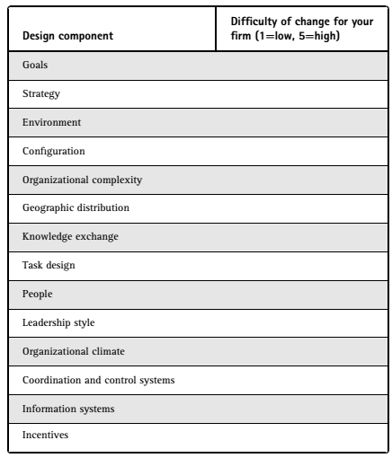
What are the difficulties of change?
Develop your own chart by filling a table.
Identify the ratings of difficulty of change in a range scale between 1 and 5.

Slide 22
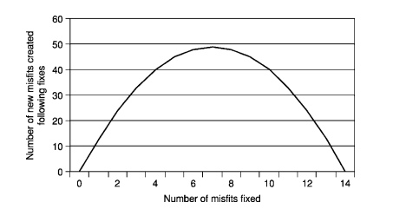
What are the difficulties of change?
Change is not a simple process:
Fixing a misfit may create other misfits
Fixing a misfit may not always reduce the total number of misfits
Fixing misfits between steps is always needed.

Slide 23
Example 3
Total fit
1

Slide 24
Example 3
Total fit
1
Then, new senior
executive arrives and prefers ‘leader’ as a leadership style
2

Slide 25
Example 3
Total fit
1
Assume the strategy is changed to a prospector to fit the new leader;
Now you have those two in fit, but each of those two is in misfit
Then have more total misfits.
3
2

Slide 26
Outline
Introduction
Where are you in the step by step approach?
What should you change first? And Second?
Why change? Should we live with some misfits?
What are the benefits of change?
What are the difficulties of change?
Managing misfits over time
Dynamic fit and time
The organizational life cycle
Summary

Slide 27
Managing misfits over time
Misfits arise from three sources
External to organization (such as new market opportunities)
Internally managerial action (such as a change in organizational strategy)
Jointly from a combination of external and internal sources

Slide 28
Managing misfits over time
Examples of change that you might make in an organization.
A new strategy for the firm
A new product or new product line
A new way of designing work tasks to satisfy new customer needs
A new information system
A different approach to people management and incentive system design
Hiring or promoting a new top management team with a different leadership style
A new approach to optimal sourcing
Greater reliance on virtualization for knowledge exchange
A major expansion or growth
A merger with another firm
A strategic alliance or partneship with another firm

Slide 29

The financial crisis 2008–10 How companies in quadrant D respond to environmental changes?
Some firms made modifications in each step Design dynamics as suggested above.
Cut cost,
Reduced debt,
Introduced high focus on productivity,
Reduced product lines and services to have a more narrow focus, Slowed down innovation.
Try to make a quick jump from quadrant D to quadrant B.

Slide 30
Outline
Introduction
Where are you in the step by step approach?
What should you change first? And Second?
Why change? Should we live with some misfits?
What are the benefits of change?
What are the difficulties of change?
Managing misfits over time
Dynamic fit and time
The organizational life cycle
Summary

Slide 31
Dynamic fit and time
Dynamic fit observe the characteristics of the organization and if there is a misfit, then correct it by changing the observed situation to a fit state
In dynamic fit, time is the central element; the time to fix a misfit is explicit in dynamic stability
Time is utilized differently in the organizational design steps.
Time can also be considered in the short run and long run, with implications for change and opportunity losses.

Slide 32
Outline
Introduction
Where are you in the step by step approach?
What should you change first? And Second?
Why change? Should we live with some misfits?
What are the benefits of change?
What are the difficulties of change?
Managing misfits over time
Dynamic fit and time
The organizational life cycle
Summary

Slide 33
The organizational life cycle
Entrepreneurial startup
Larger functional configuration
Larger divisional configuration
The organizational life cycle affects the organization development and its characteristics.

Slide 34
The organizational life cycle
The usual growth path is startup to functional to divisional
Reversing the cycle is also possible
B
D
Functional
configuration
Matrix
configuration
Simple
configuration
Divisional
configuration
A
C

Slide 35
Summary
Examine and fix the misfits within a step and then moving on to the misfits between steps is the recommended approach.
Show costs and benefits of implementing design changes in an organization.
Misfits are not easy to fix; fixing misfits may introduce more misfits.

